Slide 1
UET Taxila's Support Chatbot

Slide 2

Group Members
Muhammad Ilyas (20-CS-83)
Muhammad Abdullah (20-CS-93)
Supervisor:
Dr. Rabbia Mahum

Slide 3

Table of Content
Problem Statement
Aim and Objectives
Works Implementation
Deliverable
Literature Review
Methodology
Implementation
Conclusion

Slide 4
Problem Statement
Many students face the challenge of having to personally visit the University help desk for inquiries, resulting in significant time and financial burdens, especially when the University is located at a considerable distance from their native place.
Students face the Queries of Administrative Procedures, Hostel and Accommodation, Courses Information, Transportation, Clearance etc...
It ensures that the chatbot provides accurate and meaningful information to users.

Slide 5
Aims
Enhance user experience
Improve customer service
Support multiple platforms
Personalize interactions
Gather valuable user insights and data.
Provide timely and accurate assistance
Increase efficiency and save time for users.

Slide 6

Objectives
Prime objectives of the project are:
Enable natural and human-like conversations by leveraging NLP techniques and Python programming.
Accurately understand user queries and extract relevant information to provide informative responses.
Enhance user experience by offering intuitive and seamless interactions that effectively meet user needs.

Slide 7
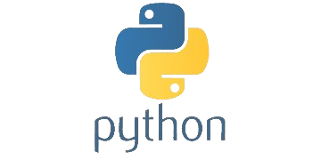
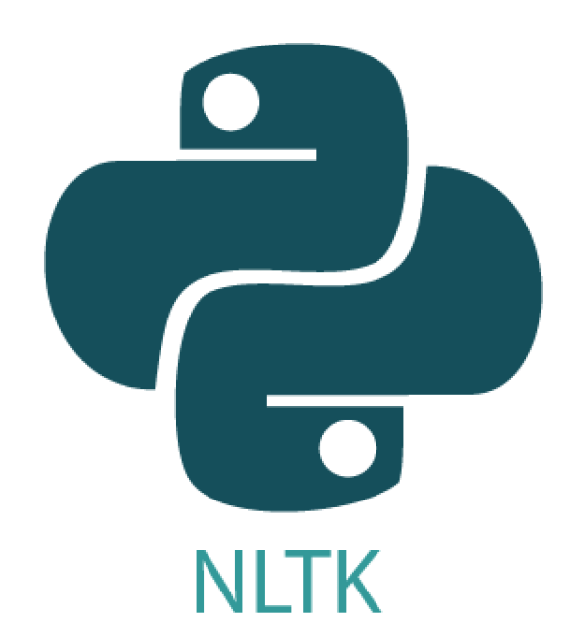

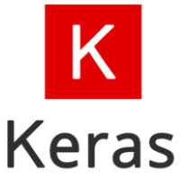




Works Implementation
Python
Natural Language Toolkit (NLTK)
VS Code
Keras
Flask
HTML& CSS
JSON

Slide 8


Deliverable
The first deliverable would be a report that provides a detailed account of the methodology used in the analysis. This report will include information on the specific techniques and tools used for data processing and conversation.
The second deliverables include an efficient and responsive system that can understand and generate appropriate responses to user queries.

Slide 9



Social Impact
01
Increased accessibility
02
Student Support
03
Streamlined Communication
Notes:
So while creating and exploring the project on primavera we observed the following key beneficial feature.
First of all risk management: we can Identify, track and resolve risks before they become issues .
2nd ly we see it’s the best software for client you are dealing with as we can develop A dashboard to track key project metrics and share it with our clients.
It’s flexible when it comes to organizing lots of activities, with one platform that allows users to prioritize, execute and monitor their work
3rd Real-time reporting provides meaningful data delivered fast, either on-demand or scheduled.
4th and lastly we can develop a structured and hierarchical view so we can manage and make work collaboratively in team

Slide 10
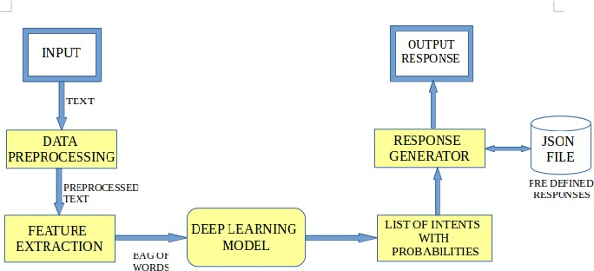
Literature Review

Slide 11

Methodology
Data collection
01
Data pre-processing
02
Development of conversational logic
03
Integration with Web
04
05
Evaluation and refinement

Slide 12
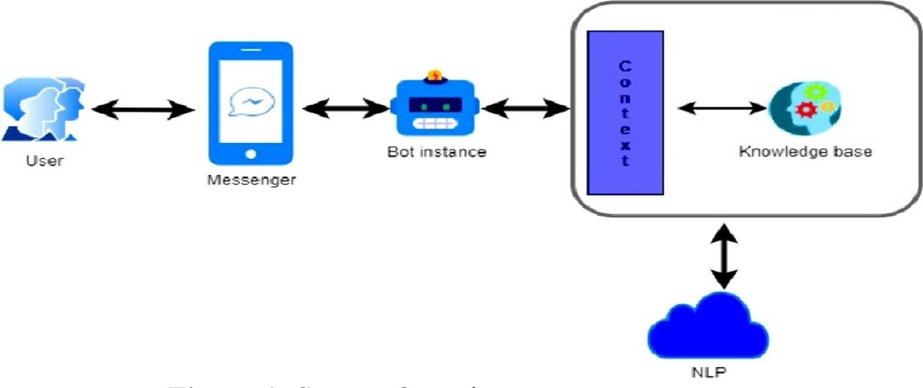
Working Model
hjsudckdhueycjndjh

Slide 13
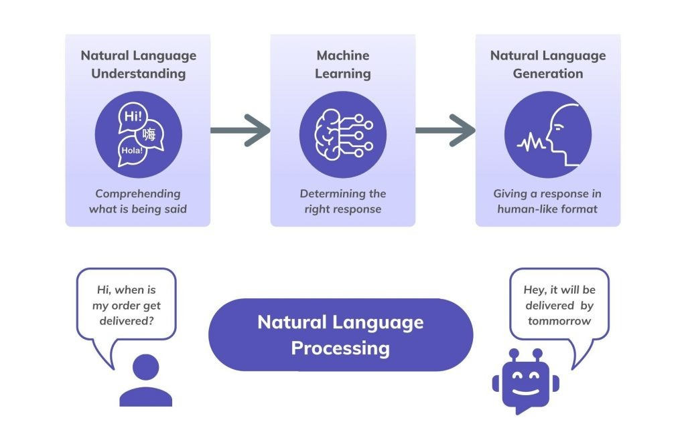
Working Model

Slide 14
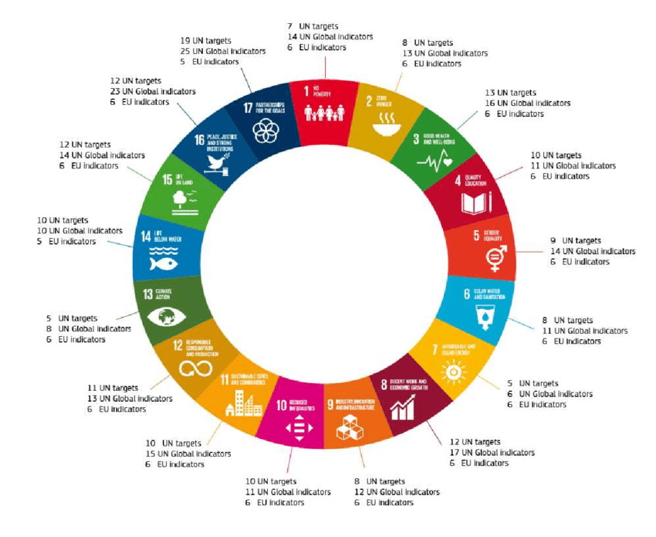


Sustainable Development Goals

Slide 15
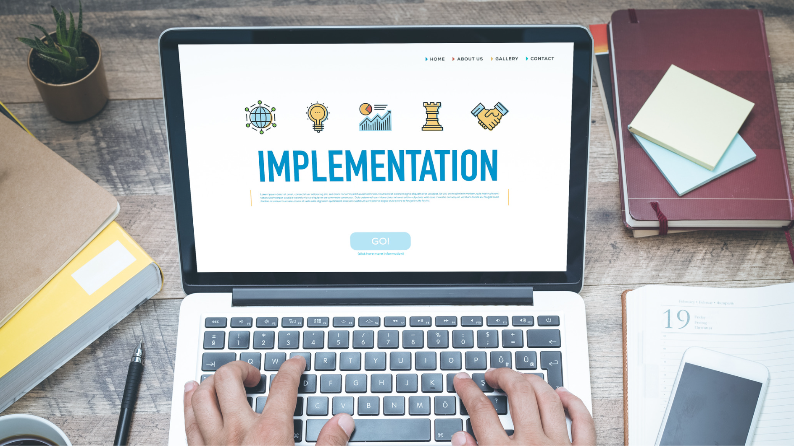
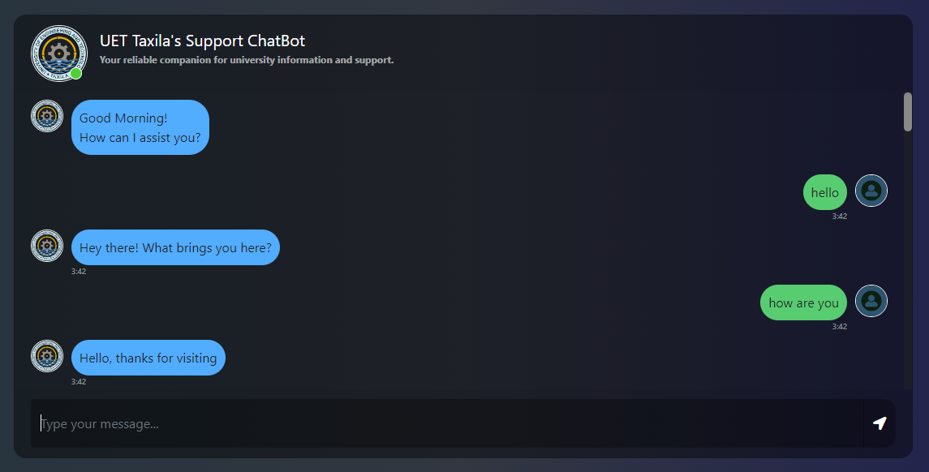
Results

Slide 16

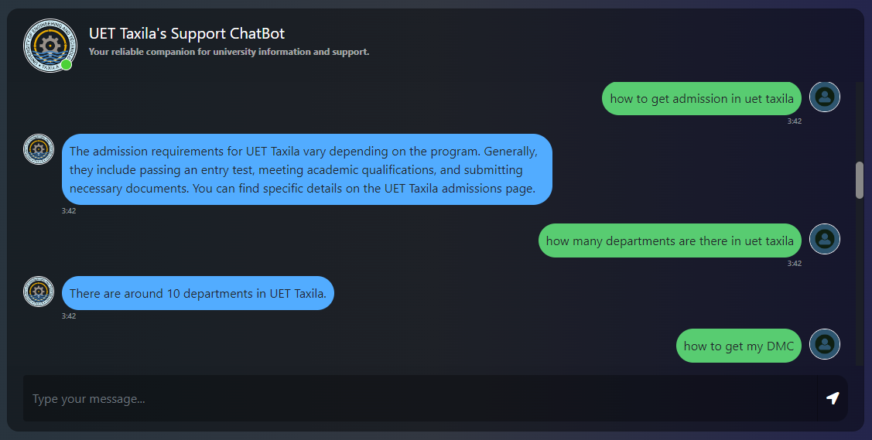
Results

Slide 17
Conclusion
we have developed a chatbot that utilizes a dataset to provide answers to our questions. The chatbot's output demonstrates its ability to understand our queries and generate appropriate responses by retrieving answers from the dataset.
Chatbot serves as a valuable tool for users seeking information and demonstrates the potential of AI in delivering efficient and precise responses.

Slide 18

THANK YOU!

